Slide 1
Operating systems
Lecture #3
Modern OS characteristics

Slide 2
(Instead of) Introduction
Please explore these info:
https://www.netacad.com/careers/career-advice/essential-skills

Slide 3
Basic Unix/Linux commands
cd (change directory) – used to navigate through the filesystem
cd ..
cd
cd ~
cd $HOME
cd /etc/opt (see the difference between absolute paths and relative paths !)

Slide 4
Basic Unix/Linux commands
pwd (print working directory) – used to display the current working directory
ls (list) – used to display the content of a directory
ls
ls –lS
ls –lSr
ls -la
ls -R
ls –lR > alist.txt (see the redirection operators, > and >>)

Slide 5
Basic Unix/Linux commands
mv (move) – used to rename a file
mv file1 file2
mv file1 dir1
cp (copy) – used to copy a file
cp file1 file2
cp –r (for a recursive copy)

Slide 6
Basic Unix/Linux commands
rm (remove) – used to?...
rm file2
rmdir (remove directory) – used to ?... an empty directory
rmdir empty_dir
rm –r not_empty_dir

Slide 7
Q 1
ls –l | pause
cat files > pause
cat files | more
ls –l | more
Which of the following commands will list the contents of the current directory screen by screen ?

Slide 8
Q 2
-w
-i
-r
-F
If we’d like to copy or move a file in another location and to be warn not to accidentally erase an existing file, what option we may use?

Slide 9
Q 3
cp test /dir2
cp test ../dir2
copy test ../dir2
cp /notes dir2
The current directory is /home/stud1010/dir1. If we want to copy the file test from the current directory into /home/stud1010/dir2 directory, what command we will use?

Slide 10
Q 4
whoisloggedon | sort
who |sort
whois | sort
id | sort
In order to see who is connected to the system, and the result sorted by user id, what command we may use?

Slide 11
Q 5
chmod g+x fisier
chmod u-e fisier
chmod g+e fisier
chmod o+x fisier
Which of the above commands will grant execution right for the group ?

Slide 12
Q 6
chmod 742 fisier
chmod 754 fisier
chmod 764 fisier
chmod 731 fisier
Which of the above commands will grant rights for read, write, execution for user, rights for read and write for the group and right for read for others?

Slide 13
Control characters in UNIX/Linux
So called control characters are used to perform some functions, like stopping or continuing displaying on the screen, terminating program execution, etc.
Most of PC keyboards have two control keys (Ctrl keys), left down, respectively right down. When it is displayed on the screen, the Ctrl key is represented as a caret sign: ^
Control characters examples:
-Ctrl-s – it stops displaying on the screen
-Ctrl-q – it continues displaying on the screen (stopped with Ctrl-s)
-Ctrl-c – it stops the current activity and it is used to stop processes and displays on the screen.
-Ctrl-d – means the end of file or exit, used to get out of some Unix utilities, exit from a terminal window or for logout.
-Ctrl-u – it erases the command line, being a quick way to erase a command line we don’t want to execute anymore.
-Ctrl-w – it erases the last word inserted to the command line
-Ctrl-h – it erases the last character inserted to the command line, used when <BACKSPACE> key doesn’t work

Slide 14
File types
the file command
general syntax:
file name_of_file
The result of the command ca be: text, executable, data, directory, etc.
-bash-3.00$ file I*
ICR.pdf: Adobe Portable Document Format (PDF) v1.4
See also: which, type commands

Slide 15
How to see the contents of an ASCII text file
cat
General syntax:
cat file_name
more
General syntax:
more file_name
head
General syntax:
head [-n] file_name
tail
General syntax
tail [-n] nume_fisier

Slide 16
Other commands to work with files
wc (word count) – used to count lines, words, octets or chars in a file
General syntax:
wc [option] file_name
where the options are:
-l lines
-w words
-c octets
-m characters
Sample output:
wc pico.save
4 13 64 pico.save
4 lines, 13 words, 64 octets

Slide 17
Other commands to work with files
diff (difference) –used to compare two text files to see the differences between them
General syntax:
diff [option] file_1 file_2
The result of the command prints out the differences line by line
We may use two options:
-i is ignoring the differences between small and caps letters
-c it offers a detailed comparison between the files

Slide 18
Unix commands on short
http://www.computerhope.com/unix.htm

Slide 19
The modern OS characteristics
Microkernel architecture
Multithreading
Symmetrical multiprocessing
Distributed OS
OOP

Slide 20
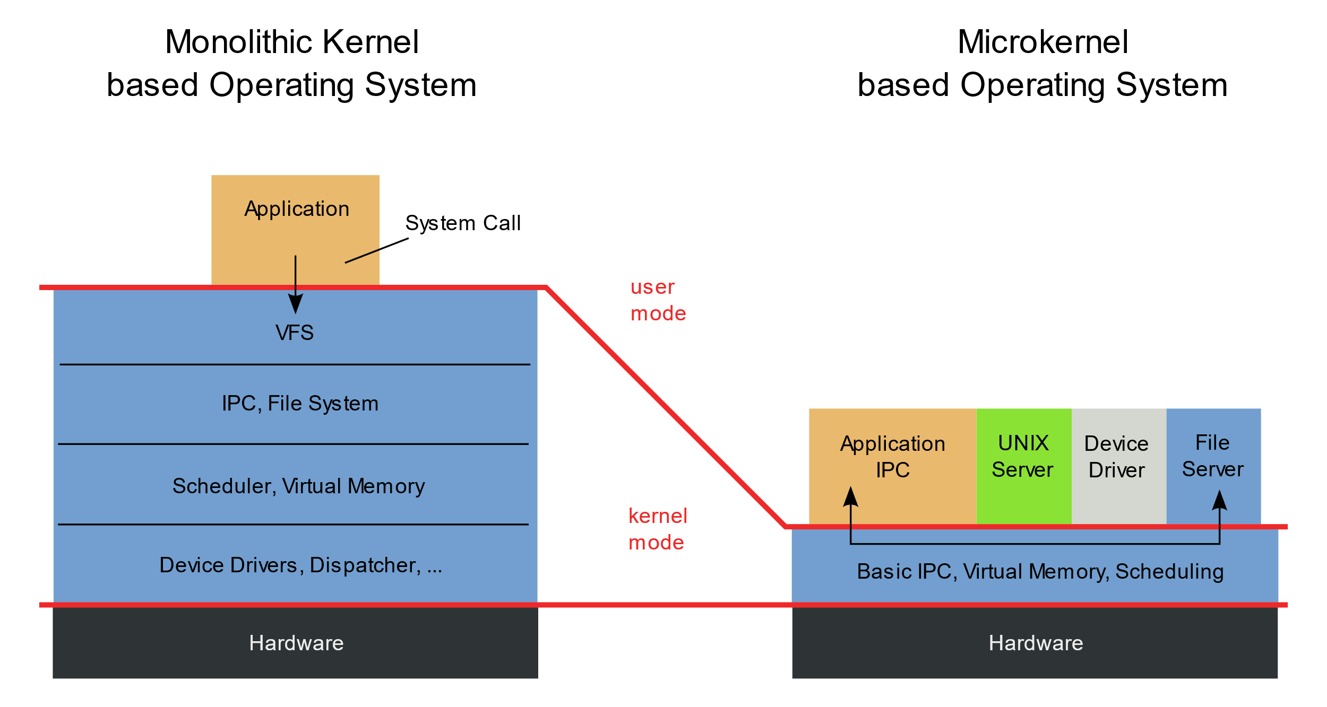
The modern OS characteristics
Microkernel architecture

Slide 21
The modern OS characteristics
Multithreading
A multithreading operating system is an operating system that supports and manages multithreading within a computer system. Multithreading is a programming and execution model that allows multiple threads (smaller units of a process) to execute concurrently within a single process. Each thread represents a sequence of instructions, and multiple threads within a process can run independently and share resources.
In a multithreading operating system, the operating system kernel is capable of managing and scheduling multiple threads of execution concurrently. This allows for more efficient use of CPU resources and improved responsiveness in handling tasks, as different threads can execute simultaneously.

Slide 22
The modern OS characteristics
Symmetrical multiprocessing
Symmetric Multiprocessing (SMP) refers to a type of multiprocessing architecture in which two or more identical processors are connected to a single shared main memory and are controlled by a single operating system instance. In an SMP system, each processor has equal access to the system's resources, including memory and I/O devices. This architecture allows multiple processors to work on different tasks concurrently, improving overall system performance.
SMP is widely used in modern computer systems, ranging from servers to personal computers. It provides a straightforward and efficient way to harness the power of multiple processors for parallel processing, allowing for better performance and responsiveness in multitasking environments.

Slide 23
The modern OS characteristics
Distributed OS
A distributed operating system is an operating system that runs on multiple machines and enables them to work together as a single, unified computing environment. In a distributed operating system, resources such as processing power, memory, and storage are distributed across the network, and the system provides a transparent and integrated view to users and applications.
Examples of distributed operating systems include Google's Chrome OS, which leverages a distributed architecture for cloud-based services, and various flavors of Linux designed for distributed computing environments.
In conclusion, a distributed operating system allows multiple machines to collaborate and share resources to provide a seamless and efficient computing environment.

Slide 24
The basic function of an OS
The basic function of an OS is the one to control the hardware, the execution medium of the programs and the user interface/s.

Slide 25
Operating models
Operating models:
Peer-to-peer
Client-server
Mainframe

Slide 26
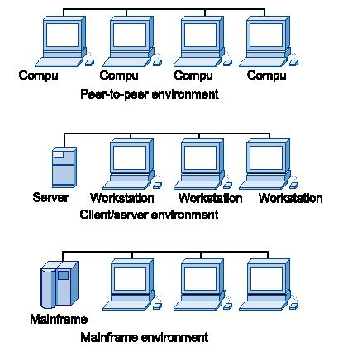

Slide 27
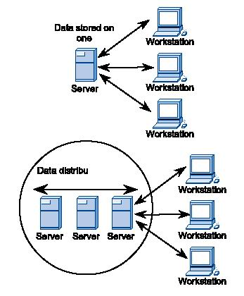

Slide 28
 | Multi-user systems
Examples: Unix/Linux, Windows Vista/7/8/10/11, Mac OS-X/macOS

Slide 29
 | Multitasking systems
Multitasking means that, internally, the OS is capable to execute multiple tasks or processes simultaneously.
This is done by a piece of software called scheduler, integrated in the execution environment. The scheduler has the role to allocate processor’s time, memory and other elements of the system for several tasks in order to enable systems’ resource sharing.
Each user on a multiuser system it has a separate task/process on a server. These tasks are created dynamically as users are connecting on the system or, on the contrary, they are deleted when users are disconnecting from the server.

Slide 30
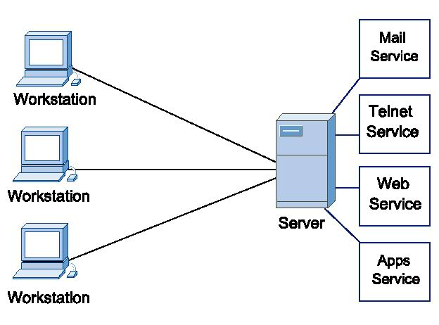
Multitasking/Multiuser

Slide 31
Multithreading
The servers are capable to run concurrent copies of a command in the same time. This enables the execution of more instances of the same service or thread of a program. A thread is describing a program (or part of a program) that has the capacity to execute independently from others.
The “multithreading” operating systems enable programmers to design programs that can be run separated in different threads of execution in a concurrent manner.

Slide 32
Multiprocessor servers
For superior execution speeds, some systems are equipped with more processors. These systems are capable to execute simultaneous tasks in parallel.
The aggregate processing power is a lot improved in this case.

Slide 33
Cooperative vs. preemptive multitasking
Cooperative multitasking means that the programs exchanges memory addresses and data in a “free” way.
The programs are written to give up using the processor after a while, in order to allow other programs to use the processor.
If a program is poorly written, it may monopolize the whole activity of the processor; also, if a program is blocking, it may block other programs, too. See here the infamous BSoD (Blue Screen of Death) in Windows…

Slide 34
Cooperative vs. preemptive multitasking
A much more efficient way of multitasking is the preemptive multitasking, implemented in Windows beginning with Windows 9x.
In this case, the OS controls the time allocation of the processor and the programs are running in separate memory spaces. In this way, a program cannot monopolize the whole system and, if it’s blocking, it will not affect other programs.
In Windows Task Manager (beginning with Win 2000/XP) users can see all the processes and programs that are running on a system, together with the process id’s (PIDs) used by the OS to distinct among the running processes.

